Slide 1
COMMUNICATION AT WORKPLACE 2 - Interpersonal communication - Barriers to communication
WORKPLACE PROFESSIONAL COMMUNICATION SKILLS

Slide 2
Interpersonal communication

Slide 3
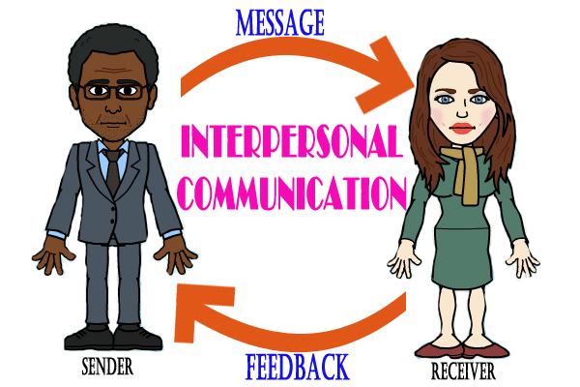
Interpersonal communication

Slide 4
What is Interpersonal Communication?
Interpersonal communication is the process by which people exchange information, feelings, and meaning through verbal and non-verbal messages: it is face-to-face communication Interpersonal communication is not just about what is actually said - the language used - but how it is said and the non-verbal messages sent through tone of voice, facial expressions, gestures and body language.

Slide 5
Elements of Interpersonal Communication
The Communicators
The Message
Noise
Feedback
Context
Channel

Slide 6
Uses of Interpersonal Communication
Interpersonal communication is a key life skill and can be used to:
- Give and collect information.
- Influence the attitudes and behavior of others.
- Form contacts and maintain relationships.
- Make sense of the world and our experiences in it.
- Express personal needs and understand the needs of others.
- Give and receive emotional support.
- Make decisions and solve problems.
- Anticipate and predict behavior.
- Regulate power

Slide 7
Barriers to communication

Slide 8
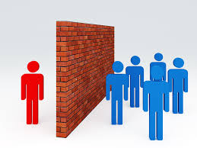
COMMUNICATION

Slide 9
Common Barriers to Effective Communication
The use of jargon
Emotional barriers and taboos
Lack of attention, interest, distractions, or irrelevance to the receiver
Differences in perception and viewpoint
Physical disabilities such as hearing problems or speech difficulties
Language differences and the difficulty in understanding unfamiliar accents
Expectations and prejudices which may lead to false assumptions or stereotyping
Cultural differences

Slide 10
Categorization of Barriers to Communication
1) Language Barriers Language and linguistic ability may act as a barrier to communication.
- For example, a message that includes a lot of specialist jargon and abbreviations will not be
understood by a receiver who is not familiar with the terminology used.
- Regional colloquialisms and expressions may be misinterpreted or even considered offensive

Slide 11
Categorization of Barriers to Communication
2) Psychological Barriers The psychological state of the communicators will influence how the message is sent, received and perceived. For example:
If someone is stressed they may be preoccupied by personal concerns and
not as receptive to the message as if they were not stressed.
Anger is another example of a psychological barrier to communication. When we are angry it is easy to say things that we may later regret, and also to misinterpret what others are saying.
More generally people with low self-esteem may be less assertive and therefore may not feel comfortable communicating - they may feel shy or embarrassed about saying how they really feel, or read unintended negative sub-texts in messages they hear

Slide 12
Categorization of Barriers to Communication
3) Physiological Barriers Physiological barriers to communication may result from the receiver’s physical state - For example, a receiver with reduced hearing may not fully grasp the content of a spoken
conversation especially if there is significant background noise.

Slide 13
Categorization of Barriers to Communication
4) Physical Barriers An example of a physical barrier to communication is geographic distance between the sender and receiver(s) - Communication is generally easier over shorter distances as more communication channels are available and less technology is required. The ideal communication is face-to-face. - Although modern technology often helps to reduce the impact of physical barriers, the advantages and disadvantages of each communication channel should be understood so that an appropriate channel can be used to overcome the physical barriers

Slide 14
Categorization of Barriers to Communication
5) Systematic Barriers
- Systematic barriers to communication may exist in structures and organizations where there are inefficient or inappropriate information systems and communication channels, or where there is a lack of understanding of the roles and responsibilities for communication.
- In such organizations, people may be unclear of their role in the communication process and therefore not know what is expected of them

Slide 15
Categorization of Barriers to Communication
6) Attitudinal Barriers Attitudinal barriers are behaviors or perceptions that prevent people from communicating effectively - Attitudinal barriers to communication may result from personality conflicts, poor management, resistance to change or lack of motivation
- To be an effective receiver of messages you should attempt to overcome your own attitudinal barriers to help ensure more effective communication.

Slide 16

ACTIVITY
Find journal articles which highlights the importance of communication in workplace!

